Slide 1
Dobson Academy-
School Improvement Plan
Jordyn Genevro
EDL 629 Principal- Signature Assignment

Slide 2
Presentation Agenda
01
Mission/ Vision
02
Root Cause Analysis
03
Principles 1-6
04
Principles 1-6 Description
05
Principles 1-3 Fishbone Diagram

Slide 3
Dobson Academy
Mission and Vision
“
“
Arizona Ball Charter Schools provide a personalized education to all students emphasizing comprehensive academic excellence in a safe, nurturing environment through partnering parents, students and staff.

Slide 4
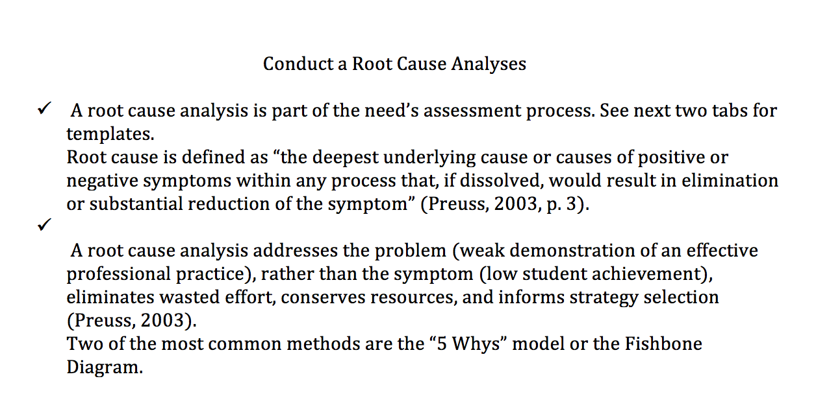
Root Cause Analysis

Slide 5
Principles 1-6
Leadership
Effective Curriculum
01
04
PD curriculum implementation.
Monitors and reviews effectiveness of adopted curriculum
Equitable distribution of highly qualified and effective teachers.
Effective Teachers
Condition, Climate, Culture
02
Instruction, ongoing academy, mentoring opportunity, collaboration with other teachers, admin, & educational professionals.
05
Our school offers services to fully support the academic and social needs of students.
Family & Community Engagement
03
Effective Organizational Time
06
Positive relationships matching business and coordinate community resources, community agencies/ social emotional & Academic Needs
School calendar organization and maximization of instruction

Slide 6
Principle 1- Leadership
Equitable distribution of highly qualified and effective teachers
Effective leaders maintain strong professional ethics and integrity to shape a vision of academic success for all students. They analyze and attack challenges and manage systems to position the school and students to achieve at high levels. They set clear, measurable and attainable goals. They create a cadre of high-quality teachers and cultivate leadership in others.

Slide 7
Instruction, ongoing academy, mentoring opportunity, collaboration with other teachers, admin, & educational professionals.
Principle 2- Effective Teachers
Effective instruction occurs with quality teaching in a student-centered, safe environment where there are high expectations for all students to succeed. Teachers have a solid knowledge of the content they teach and a common understanding of the content standards and curricula. It includes intentional planning and emphasizes evidence-based best practices for teaching and learning. It also requires teachers to have a strong understanding of the assessment system and how to use data to make instructional decisions for all students.

Slide 8
Principle 3- Effective Organizational Time
School calendar organization and maximization of instruction
Effective schools organize their time to support the vision of academic success for all students. Students have appropriate instructional and non-instructional time to support their learning and growth. Teachers have sufficient time to engage in professional learning, collaboration, and planning to support their students and their professional practice.

Slide 9
Principle 4- Effective Curriculum
PD curriculum implementation
Monitors and reviews effectiveness of adopted curriculum
Effective curricula are evidence-based resources used for teaching and learning aligned to Arizona standards in all content areas. Districts and schools adopt local curricula. An effective curriculum ensures a continuum of inclusive, equitable and challenging learning opportunities, high expectations for learning and access to a well-rounded education for all learners.

Slide 10
Principle 5- Condition, Climate, Culture
Our school offers services to fully support the academic and social needs of students
Inclusive schools are conducive to student learning, fulfillment and well-being, as well as professional satisfaction, morale and effectiveness. Students, parents, teachers, administrators and other stakeholders contribute to their school’s culture, as do other influences such as the local community, the policies that govern how it operates and the school’s founding principles. School conditions, climate and culture are impacted by the beliefs, perceptions, relationships, attitudes and written and unwritten rules that shape and influence every aspect of how a school functions. They also encompass concrete issues such as student physical and emotional safety, a healthy school environment, the orderliness of classrooms and public spaces and the degree to which a school embraces and celebrates racial, ethnic, linguistic, academic and cultural diversity.

Slide 11
Principle 6- Family & Community Engagement
Positive relationships matching business and coordinate community resources, community agencies/ social emotional & Academic Needs
Family and Community Engagement is an essential component of improving outcomes for children and youth. Effective family and community engagement is a reciprocal partnership among families, communities and schools that reflects a shared responsibility to foster children's development and learning.

Slide 12
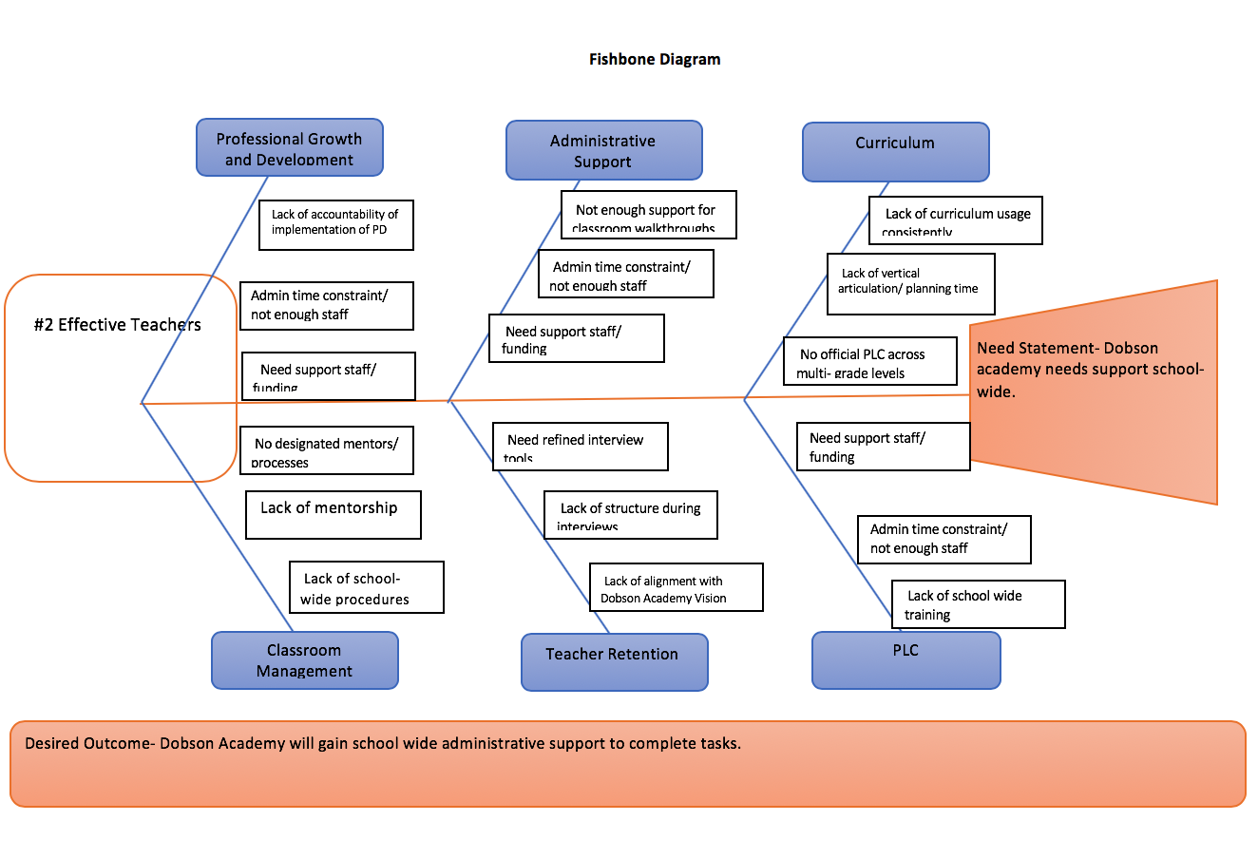

Slide 13
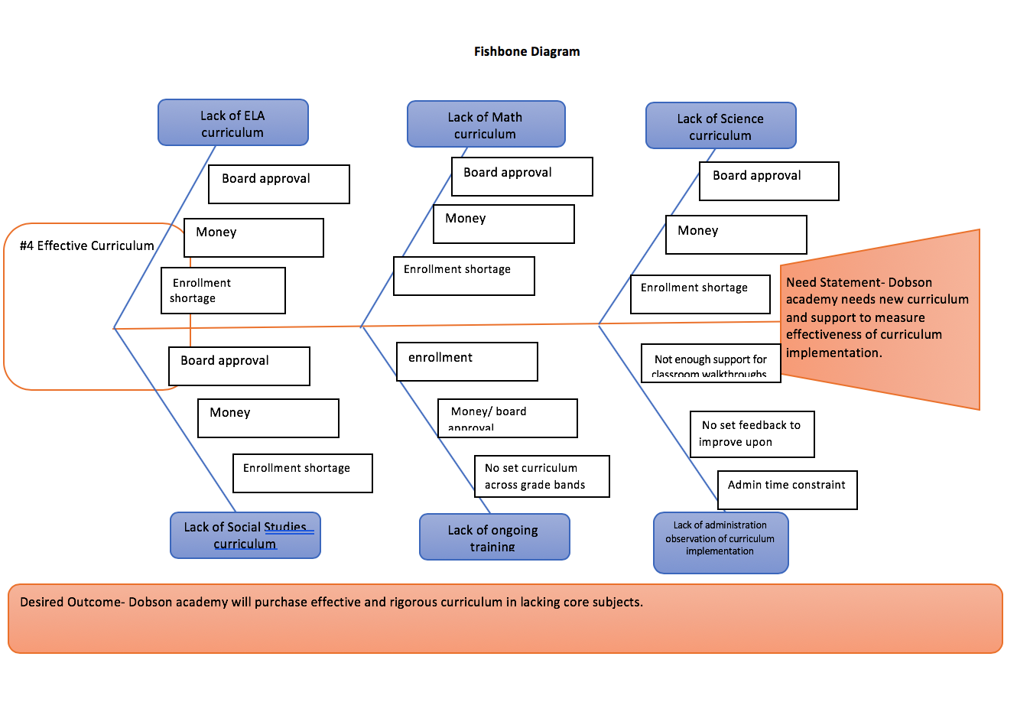

Slide 14
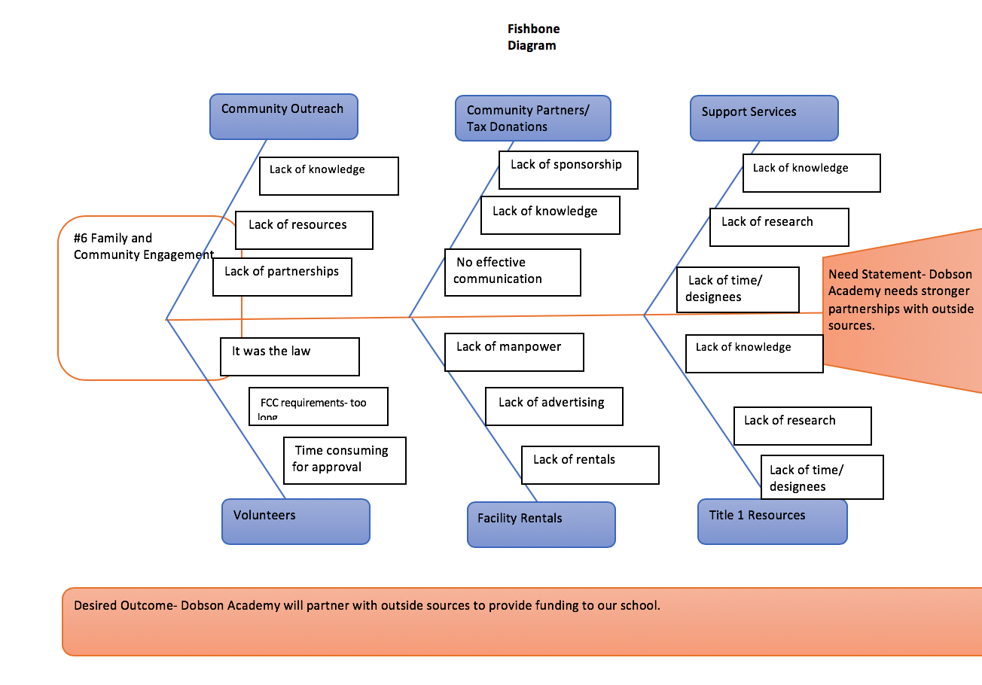

Slide 15
Thank you

