Slide 1

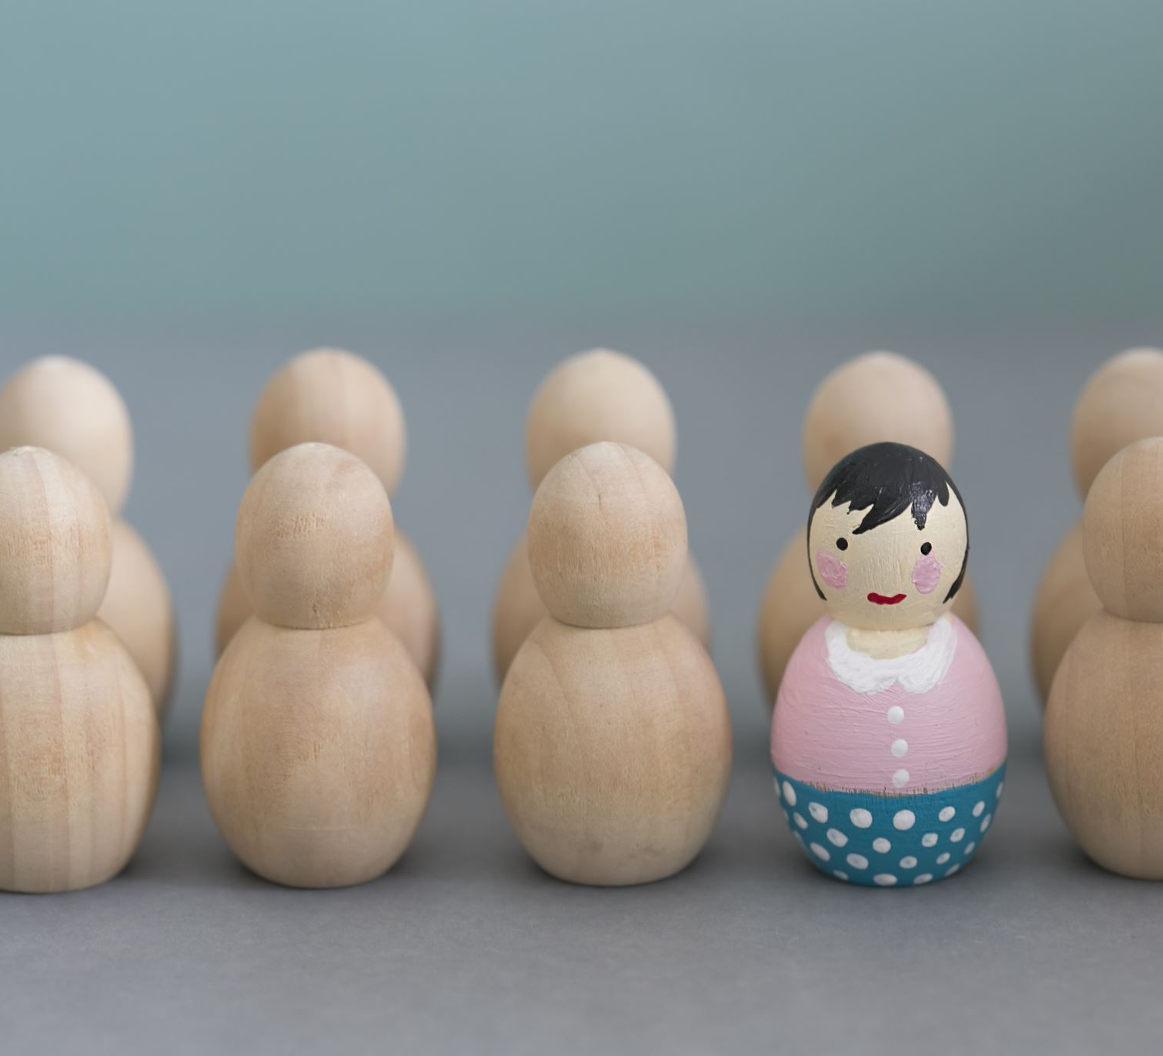
Character Traits
Mrs. Sutherland

Slide 2
Character Traits
Physical Appearance Black hair Blue eyed Tall or short | Feelings Happy Exhausted Hyperactive
Demographics/ hobbies Teacher Atlethe Collect rocks | Personality Honest Cheerful generous

Slide 3
Character Traits
Angry | hardworking | tired | humorous
Excited | brave | sad | dedicated
Selfish | sneaky | friendly | helpful

Slide 4
Character Traits
Angry | hardworking | Tired | humorous
excited | brave | Sad | dedicated
selfish | sneaky | friendly | helpful

Slide 5
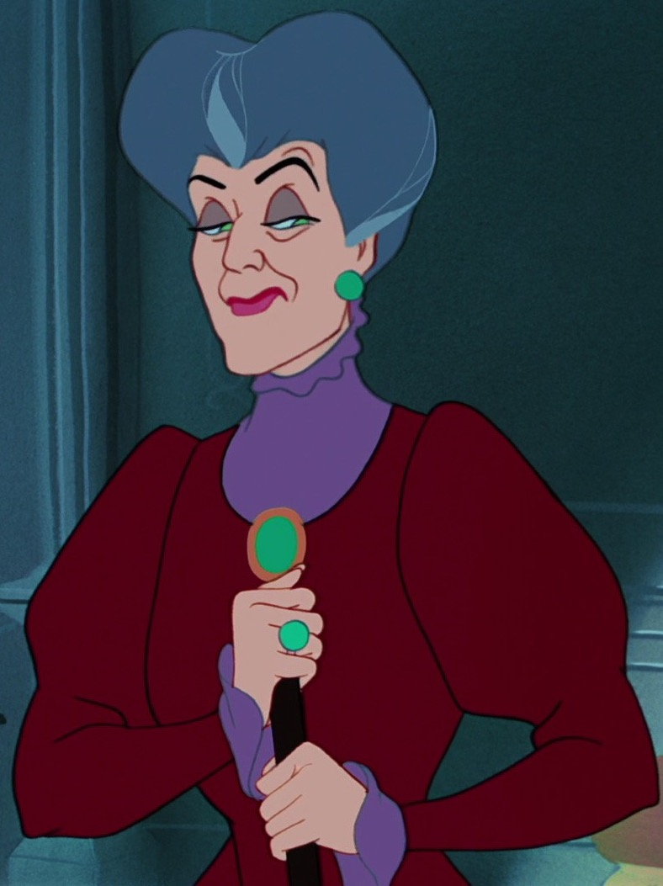
Character Traits
Lady Tremaine
Calls Cinderella a “clumsy fool”
Makes Cinderella do all the chores

Slide 6
Character Traits
Lady Tremaine
Physical Appearance | Feelings
Demographics/ hobbies | Personality

Slide 7
Questions?
Can a character trait change over time?

