Slide 1
Dobson Academy
A ball charter school

Slide 2
Root cause analysis
Conduct a Root Cause Analyses A root cause analysis is part of the needs assessment process. See next two tabs for templates. Root cause is defined as “the deepest underlying cause or causes of positive or negative symptoms within any process that, if dissolved, would result in elimination or substantial reduction of the symptom” (Preuss, 2003, p. 3). A root cause analysis addresses the problem (weak demonstration of an effective professional practice), rather than the symptom (low student achievement), eliminates wasted effort, conserves resources, and informs strategy selection (Preuss, 2003). Two of the most common methods are the “5 Whys” model or the Fishbone Diagram.

Slide 3
Category
Category
Category
Need
Statement
Primary Need
Category
Category
Category

Slide 4
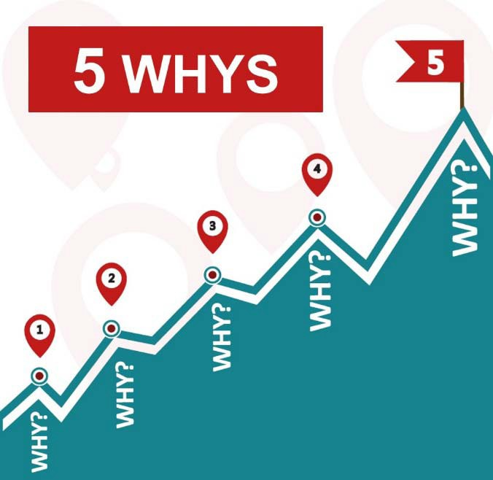
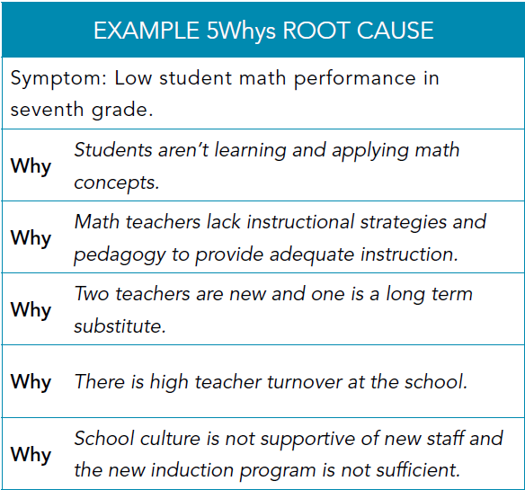

Slide 5
Principle One- Leadership
Equitable distribution on highly qualified and effective teachers
Effective leaders maintain strong professional ethics and integrity to shape a vision of academic success for all students. They analyze and attack challenges and manage systems to position the school and students to achieve at high levels. They set clear, measurable and attainable goals. They create a cadre of high-quality teachers and cultivate leadership in others.

Slide 6
Principle two- effective teachers
Instruction, ongoing academy, mentoring opportunity, collaboration with other teachers, admin, & educational professionals.
Effective instruction occurs with quality teaching in a student-centered, safe environment where there are high expectations for all students to succeed. Teachers have a solid knowledge of the content they teach and a common understanding of the content standards and curricula. It includes intentional planning and emphasizes evidence-based best practices for teaching and learning. It also requires teachers to have a strong understanding of the assessment system and how to use data to make instructional decisions for all students.

Slide 7
Principle three- effective organizational time
School calendar organization and maximization of instruction
Effective schools organize their time to support the vision of academic success for all students. Students have appropriate instructional and non-instructional time to support their learning and growth. Teachers have sufficient time to engage in professional learning, collaboration, and planning to support their students and their professional practice.

Slide 8
Principle Four- effective curriculum
PD curriculum implementation
Monitors and reviews effectiveness of adopted curriculum
Effective curricula are evidence-based resources used for teaching and learning aligned to Arizona standards in all content areas. Districts and schools adopt local curricula. An effective curriculum ensures a continuum of inclusive, equitable and challenging learning opportunities, high expectations for learning and access to a well-rounded education for all learners.

Slide 9
Principle Five- condition, climate, culture
Our school offers services to fully support the academic and social needs of students
Inclusive schools are conducive to student learning, fulfillment and well-being, as well as professional satisfaction, morale and effectiveness. Students, parents, teachers, administrators and other stakeholders contribute to their school’s culture, as do other influences such as the local community, the policies that govern how it operates and the school’s founding principles. School conditions, climate and culture are impacted by the beliefs, perceptions, relationships, attitudes and written and unwritten rules that shape and influence every aspect of how a school functions. They also encompass concrete issues such as student physical and emotional safety, a healthy school environment, the orderliness of classrooms and public spaces and the degree to which a school embraces and celebrates racial, ethnic, linguistic, academic and cultural diversity.

Slide 10
Principle six- family and community engagement
Positive relationships matching business and coordinate community resources, community agencies/ social emotional & Academic Needs
Family and Community Engagement is an essential component of improving outcomes for children and youth. Effective family and community engagement is a reciprocal partnership among families, communities and schools that reflects a shared responsibility to foster children's development and learning.

